Slide 1
Differentials, Extreme Values, & Lagrange Multipliers

Slide 2
Error Approximation

Slide 3
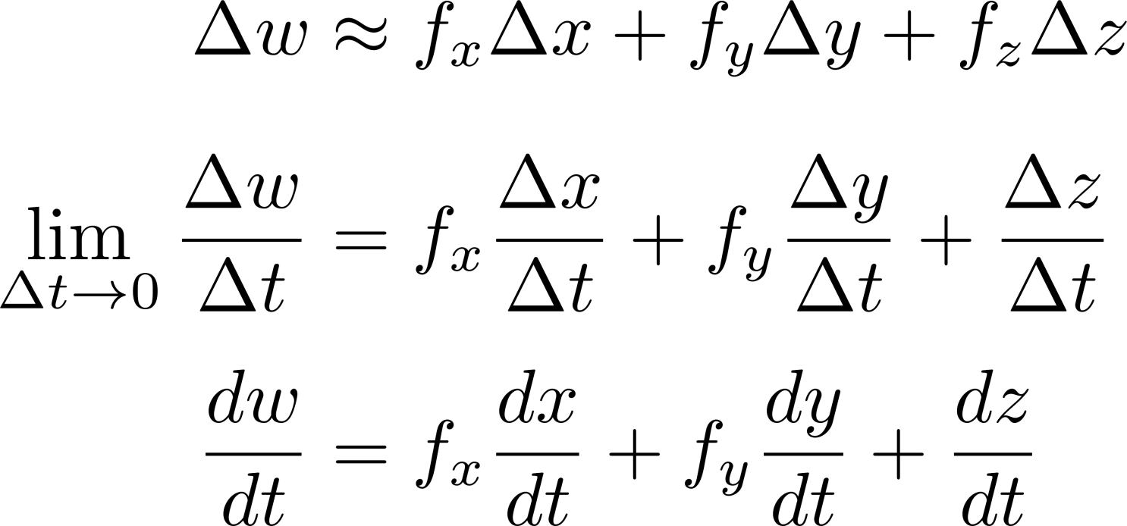
Chain Rule

Slide 4
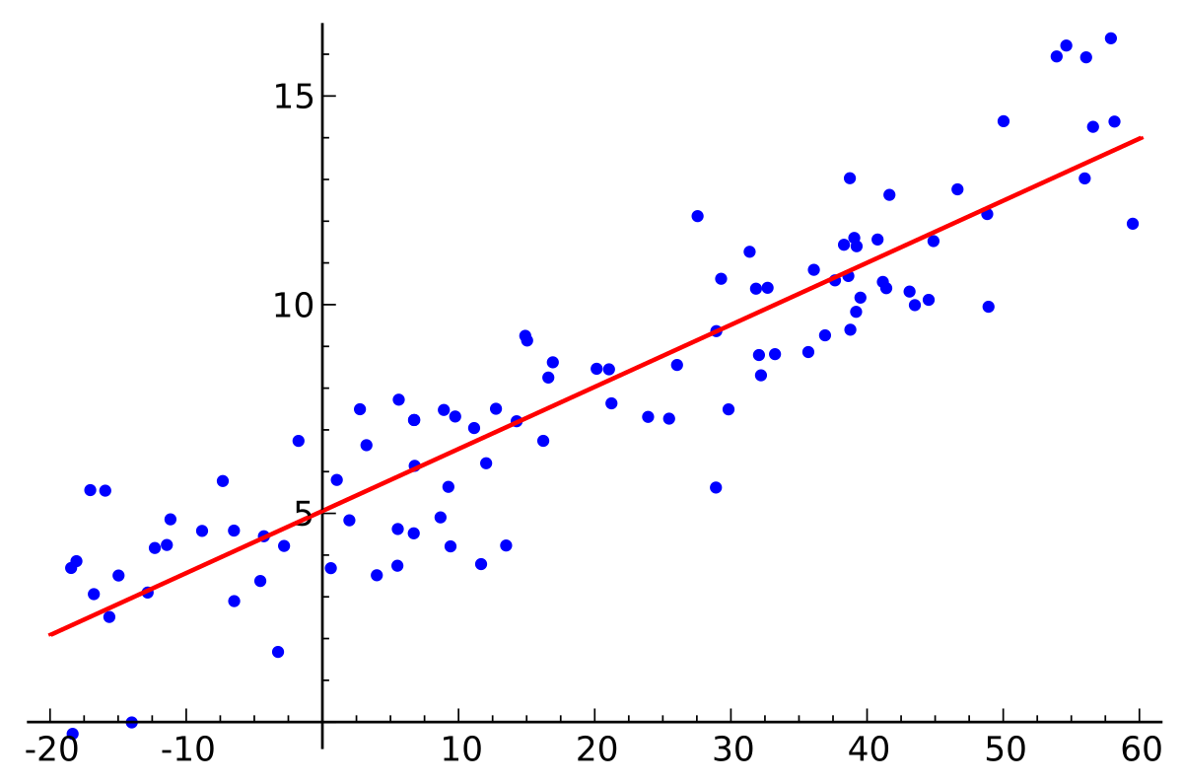
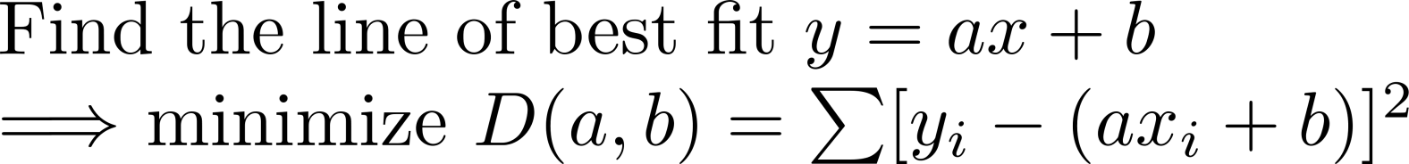
Least Squares

Slide 5
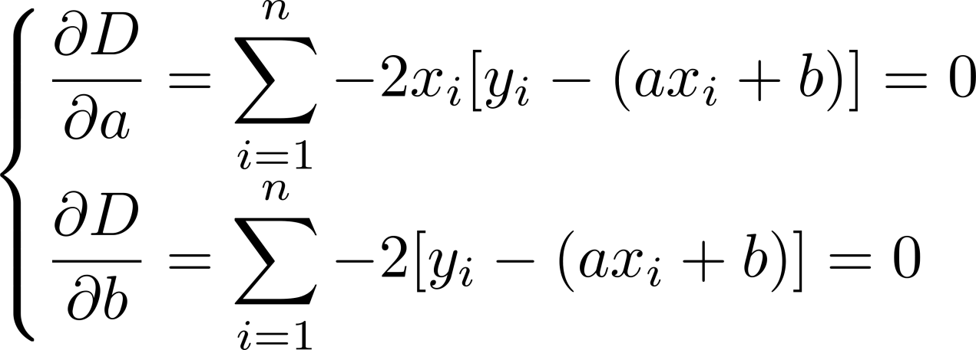

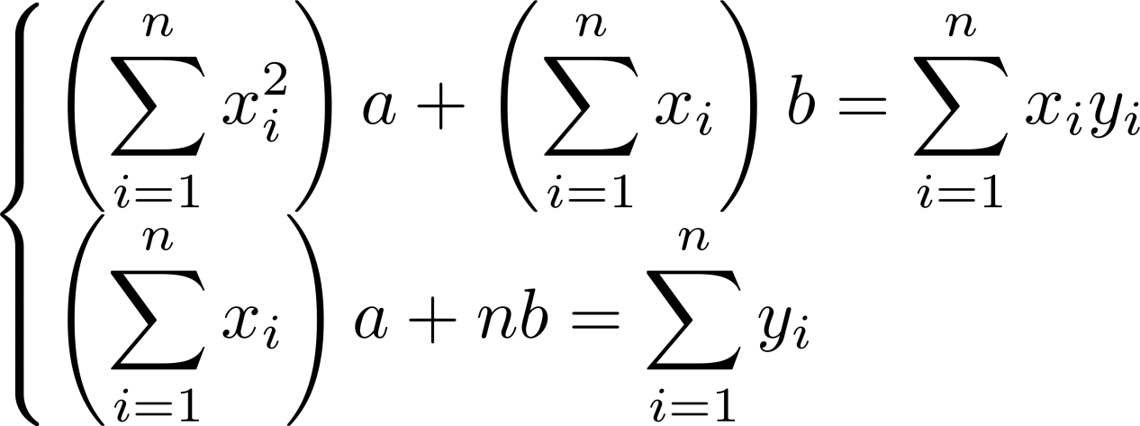
Least Squares

Slide 6
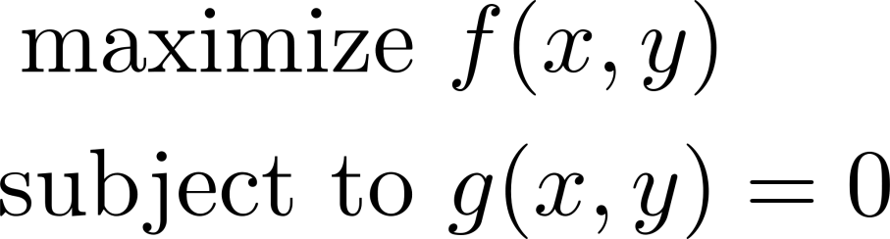
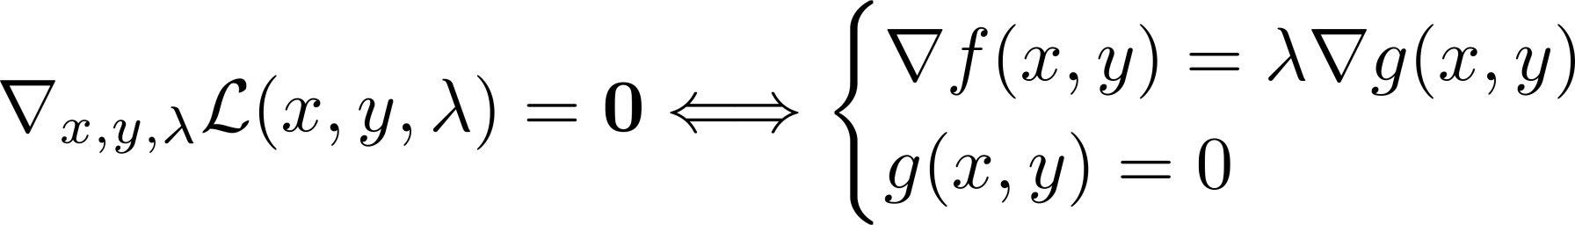
The Lagrange Function
Notes:
Motivation: using computer algorithms, it is often easier to find zeroes of the gradient on the left than to solve the system of equations right.

Slide 7
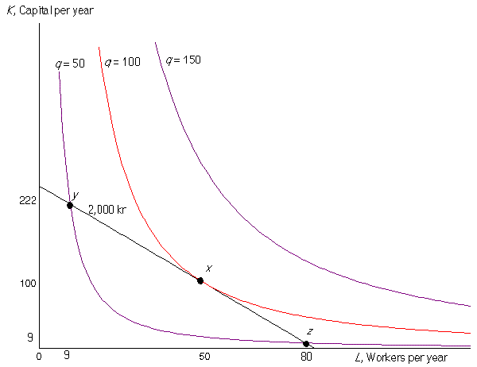
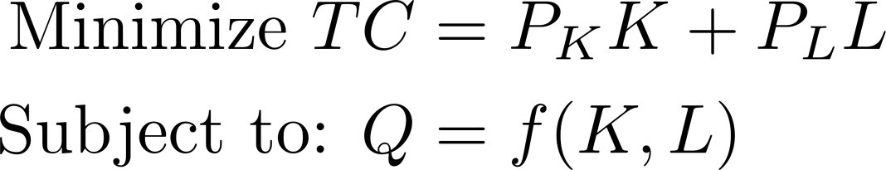
Cost Minimization

Slide 8
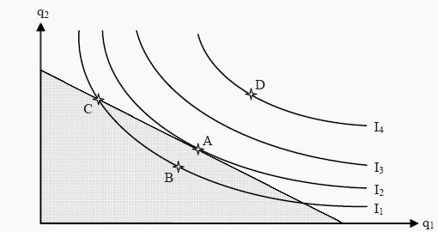
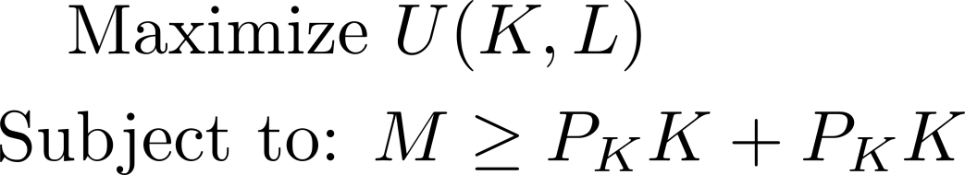
Utility Maximization

